Slide 1
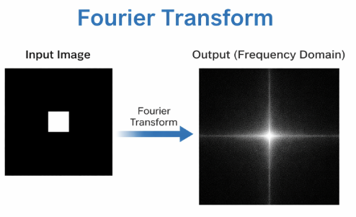

Slide 2

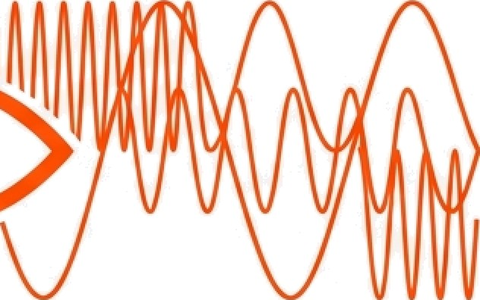

How do we really ‘see’ an image?
Pixel View
Fourier View
Standard Perspective: A grid of positions.
Frequency Perspective: A collection of changes.
The Fourier Transform changes our perspective. It helps us see an image in terms of smooth areas and edges instead ofjust a grid of pixels. It is a tool for analyzing change, not position.

Slide 3
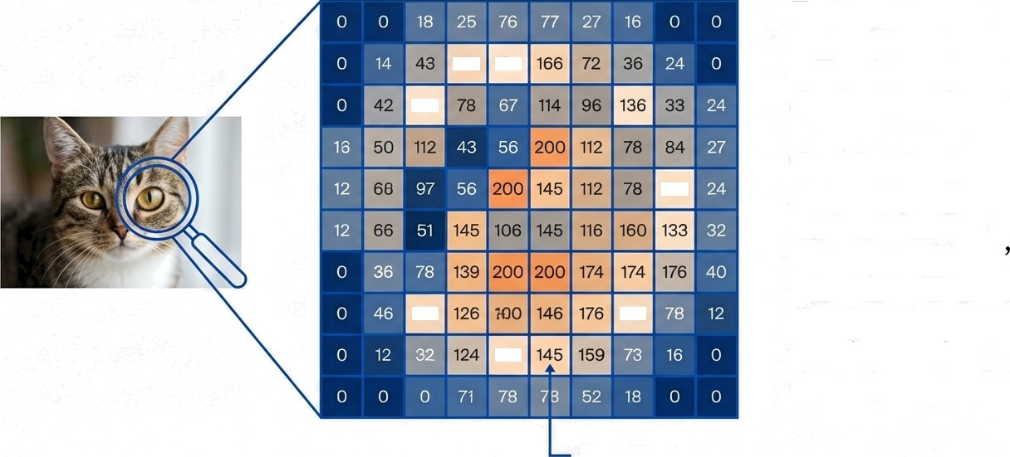
The ‘Normal’ View: The Spatial Domain
To a computer, a normal image is just a grid of numbers at specific positions.
The Problem: Looking at pixels one by one makes it hard to distinguish ‘noise from ‘detail.’ It is like looking at a forest tree-by-tree but
missing the landscape.
190 136
120
132
107
162
13B
Pixel (x, y) = Intensity Value

Slide 4
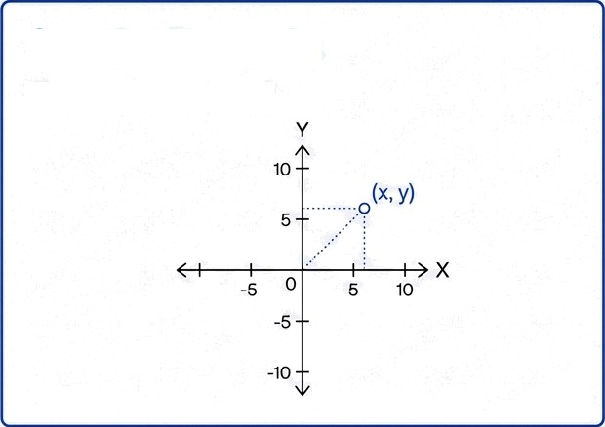
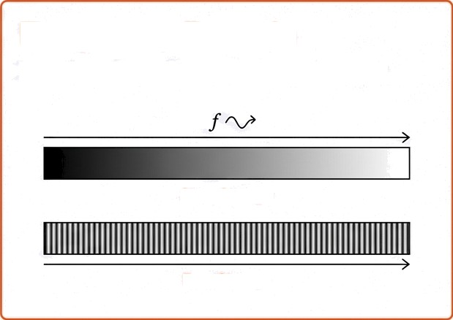
A New Perspective: The Frequency Domain
The Pourier Transform changes the question we ask.
Spatial Domain
Where is the pixel?
Frequency Domain
How fast does the brightness change?
Slow Cnange
-›0
Fast Change
In this view, every image is a combination of three components: Smooth parts, Edges, and Noise.

Slide 5
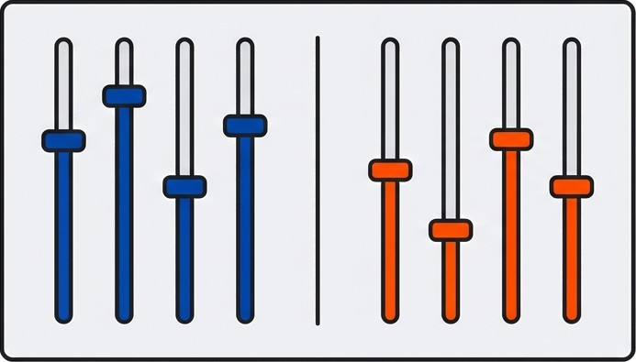
If Images Were Music...
Deep, slow sounds
Sharp, fast sounds
Think of an image like a
song. The Fourier
Transform acts like an
separating the “music” of an image into its constituent frequencies.
Bass / Low Frequency
Treble / High Frequency

Slide 6



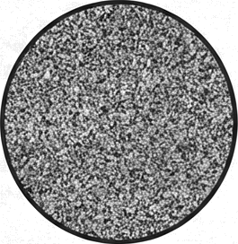
Mapping Frequencies
Images
Low Frequencies (Bass) | High Frequencies (Treble) | Very High Frequencies
Smooth backgrounds, | Object boundaries, sudden | Noise, grain, speckles.
walls, sky. Slow changes in brightness. | edges. Fast changes in | Unwanted rapid variations.
brightness.

Slide 7
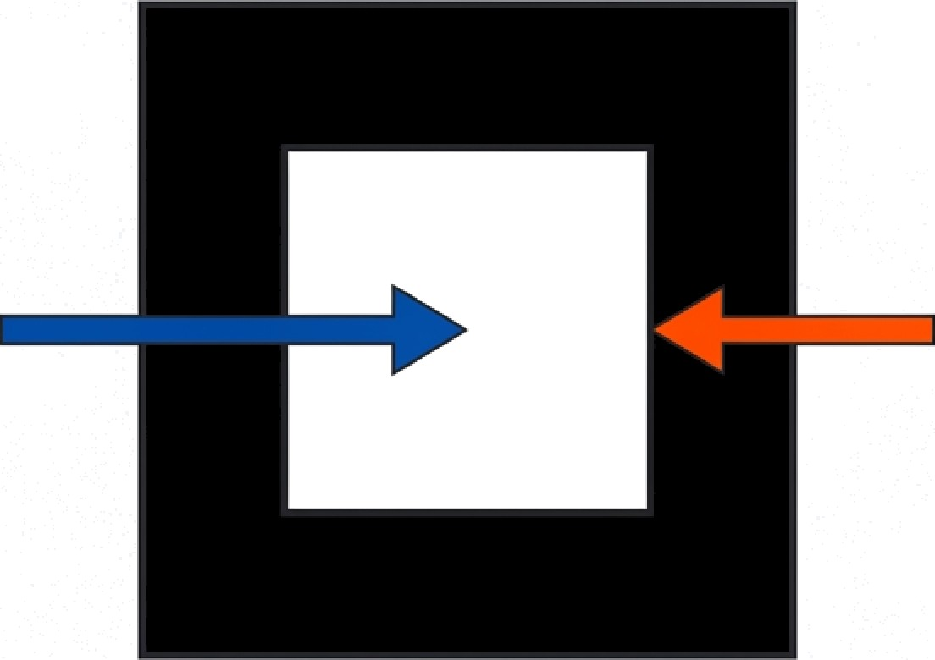
Visualizing the Change
Zero Change = Low
Frequency (Smooth)
Sudden Jump = High
Frequency (Edge)
The Fourier Transform maps exactly where the image is smooth and where the sharp edges are, based on these changes in intensity.

Slide 8
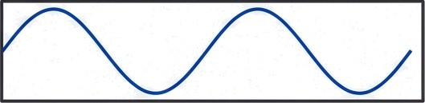
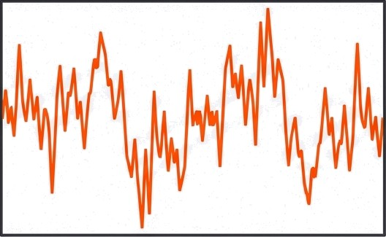
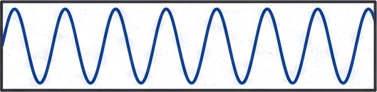
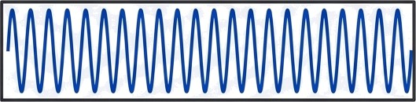
The Mathematical Mechanism
Complex Signal (Image)
The Fourier Transform decomposes a complex image into a sum of simple sine and cosine waves.
We don't need to derive the formulas yet; we just need to understand that the math measures the ‘speed' of the waves (brightness changes).

Slide 9
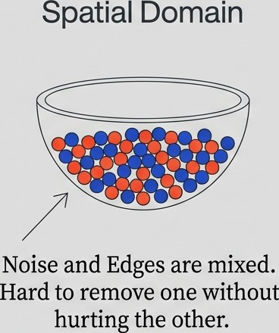
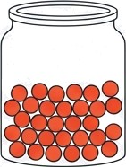



The Power of Separation
Frequency Domain
They live at different“addresses”.
We can target noise (high freQ without touching the background.

Slide 10





The Filtering Workflow
Input
Image
Fourier
Transform
Apply Filter
Remove unwanted
frequencies.
Inverse
Transform
Output Image

Slide 11
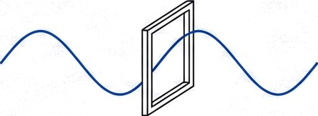
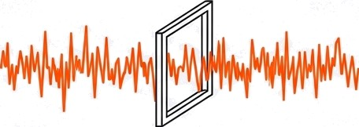
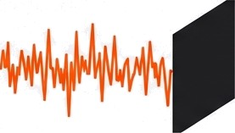
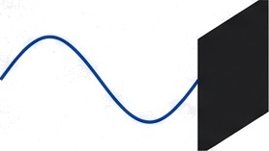
The Tools of the Trade: Filters
Low-Pass Filter
Allows low frequencies (smoothness) to pass. Blocks high frequencies.
Result: Blurring / Noise Removal.
High-Pass Filter
Allows high frequencies (edges) to pass. Blocks low frequencies.
Result: Edge Detection / Sharpening.

Slide 12
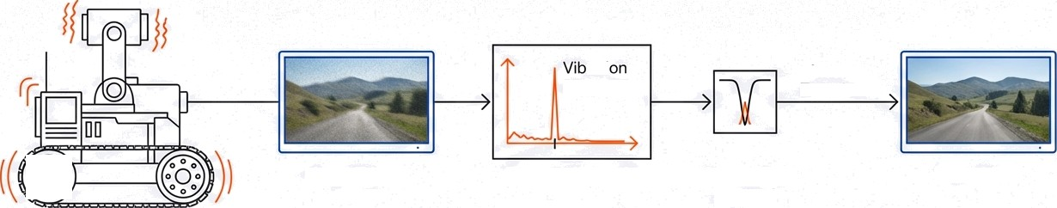



Case Study: The Robot's Vision
rati
Frequency
Inverse Transform
Noisy/Blurry
View
Fourier Analysis
Notch Filter
applied
Clear View
A vibrating robot camera creates noise. We identify the vibration frequency, remove it, and restore the video.

Slide 13




Why This Mahers for
Computer Vision
Noise Removal.
Cleaning up grainy photos.
Image Enhancement.
Sharpening blurry images.
Feature Extraction. Helping
computers find objects.
Compression. Reducing
file sizes (JPEG logic).

Slide 14



Key Definitions & Concepts
Fourier Transform
ConveGs an image from the spatial domain to the
the frequency domain.
Purpose
To analyze and process image components like edges and noise effectively.
Spatial
Domain
The normal view where an image is a collection of pixels
at (x,y).
Frequency Domain
The view where an image is a collection of brightness changes (waves).

Slide 15
Fourier Transforms USED in Computer Vision
Discrete Fourier Transform (DFT)
Fast Fourier Transform (FFT)
2D Fourier Transform
Inverse Fourier Transform (IFT)

Slide 16
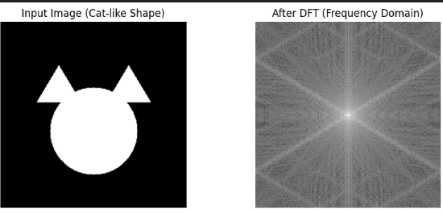
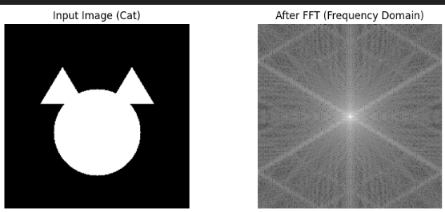
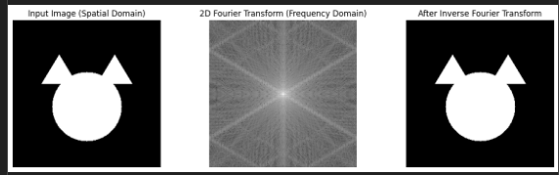

Slide 17
Pixels tell us WHERE things are.
Frequencies tell us HOW things change.

